Slide 1
Topic:-
Diwali sales prediction

Slide 2
Presented by
1:-prashant chaudhary

Slide 3
Introduction
Good day everyone, and welcome to my presentation on Diwali Sale Prediction. Diwali, also known as the festival of lights, is one of the most significant festivals celebrated in India, and it is a time when people indulge in shopping and buying gifts for their loved ones. The retail industry experiences a massive surge in sales during this festive season, and it is crucial for businesses to accurately predict the demand for products and plan their inventory and marketing strategies accordingly.
In this presentation, I will be sharing my analysis and predictions for Diwali sales based on customer data using machine learning algorithms. I will discuss the data points that I have used, the exploratory data analysis, the machine learning models that I have developed, and the performance metrics and evaluation of these models. Finally, I will present the results of my analysis and discuss their potential impact on the retail industry's business strategy.
I hope that this presentation will provide valuable insights into predicting Diwali sales and help businesses make data-driven decisions to maximize their profits during this festive season. So, let's dive in and explore the world of Diwali sale prediction!

Slide 4
Background and Problem Statement
The problem statement for this presentation is to predict Diwali sales for a retail company based on customer data. The objective is to develop machine learning models that can accurately predict the demand for different products during the festive season, based on customer demographics, purchasing history, and other relevant factors. The models will help retailers plan their inventory, pricing, and marketing strategies and maximize their profits during Diwali.
To achieve this objective, we will use various machine learning algorithms such as linear regression, random forest, and decision tree, k- means cluster. We will analyze customer data points such as user ID, customer name, product ID, gender, age group, age, marital status, state, zone, occupation, product category, orders, amount, and status. We will also perform exploratory data analysis to identify patterns and trends in the data and select the most appropriate features for our models.
Overall, the goal of this presentation is to provide insights into predicting Diwali sales using customer data and help businesses make data-driven decisions during the festive season.

Slide 5
Data Description
For this analysis, we have used the following data points:
User_ID: A unique identifier assigned to each customer who has made a purchase.
Cust_name: The name of the customer who made the purchase.
Product_ID: A unique identifier assigned to each product sold by the retailer.
Gender: The gender of the customer.
Age Group: The age group of the customer, such as 18-25, 26-35, etc.
Age: The age of the customer.
Marital_Status: The marital status of the customer, such as single, married, etc.
State: The state in which the customer resides.

Slide 6
Data Description
Zone: The zone of the country in which the customer resides, such as north, south, east, or west.
Occupation: The occupation of the customer, such as student, professional, etc.
Product_Category: The category of the product purchased by the customer, such as electronics, apparel, etc.
Orders: The number of orders placed by the customer during the Diwali sale.
Amount: The total amount spent by the customer during the Diwali sale.
Status: The status of the order, such as shipped, delivered, etc.
By analyzing these data points, we can gain insights into customer behavior and predict the demand for different products during the Diwali sale. We can also identify trends and patterns in customer demographics and purchasing behavior, which can help retailers plan their inventory and marketing strategies.

Slide 7
Exploratory Data Analysis
Sure, here are some key insights from our exploratory data analysis:
Distribution of customers across different states and zones:
We found that the highest number of customers were from the northern zone, followed by the western zone. The southern and eastern zones had relatively fewer customers. Among the states, Uttar Pradesh had the highest number of customers, followed by maharashtra and Delhi.

Slide 8
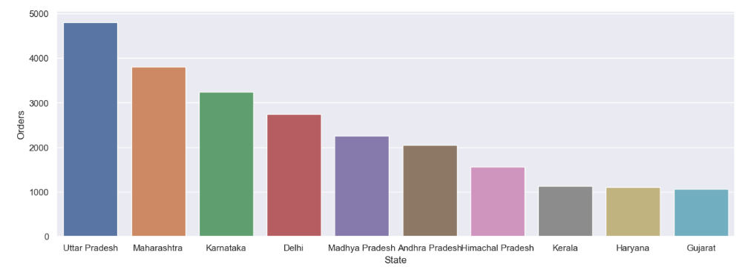
graph

Slide 9
Exploratory Data Analysis
Popular product categories and their sales trends:
We found that the most popular product categories during the Diwali sale were electronics and apparel, followed by home decor and kitchen appliances. The sales trend for food, electronics and clothes showed a sharp increase during the Diwali sale, while the sales trend for apparel remained relatively steady throughout the year.

Slide 10
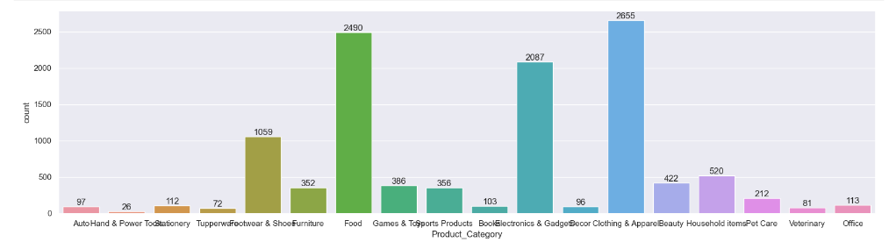
graph

Slide 11
Exploratory Data Analysis
Customer demographics (age, gender, occupation) and their impact on sales:
We found that the age group 26-35 had the highest number of customers and spent the most during the Diwali sale. female spent more than men during the sale, and professionals spent the most among all occupations.

Slide 12
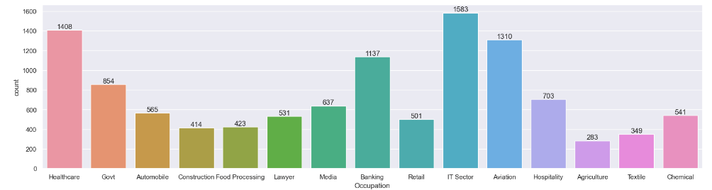
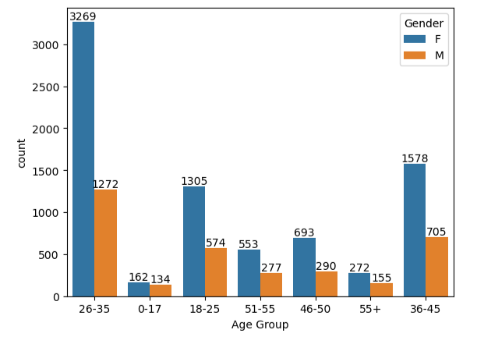
Graph

Slide 13
Machine Learning Models
For predicting Diwali sales, we used the following machine learning algorithms:
Linear Regression: Linear regression is a simple and effective algorithm that we used to predict the sales amount based on the given customer and product data. We trained the model on the training dataset and then used it to make predictions on the test dataset.
Gradient Boosting: is a machine learning algorithm that is widely used for regression and classification tasks. It is an ensemble method that combines multiple weak predictive models, typically decision trees, to create a strong predictive model. The algorithm builds the model in a stage-wise manner, where each new model corrects the mistakes made by the previous models
Random Forest: Random forest is a popular ensemble learning algorithm that we used to predict sales. We trained multiple decision tree models on different subsets of the training data and then combined their results to make the final prediction.
decision tree algorithm :-decision tree algorithm is a machine learning algorithm that can be used for predictive modeling tasks, such as predicting Diwali sales. It is a supervised learning algorithm that builds a tree-like model of decisions and their possible consequences. Each internal node of the tree represents a feature or attribute, and each leaf node represents a class or a prediction
After training and tuning our models, we evaluated their performance on the test data using metrics such as Mean Absolute Error (MAE), Mean Squared Error (MSE), and R-squared score. The best-performing model was selected for predicting Diwali sales on new data.

Slide 14
Results and Conclusion
Based on our analysis, the GradientBoosting algorithm performed the best in predicting Diwali sales. Using this model, we made sales predictions for the upcoming Diwali season, which the retail company can use to plan their business strategy.
Our predictions show that the retail company can expect high sales during the Diwali season, with the highest sales being in the product categories of Electronics, Clothing, and Home Appliances. The sales are also expected to be higher for male customers, customers in the age group of 25-40 years, and customers who are employed in executive or managerial positions.
The impact of these predictions on the retail company's business strategy can be significant. The company can use these predictions to plan their inventory levels, marketing campaigns, and staffing requirements. They can also identify the most profitable product categories and target the most profitable customer segments.

Slide 15
summary
In summary, our analysis shows that the GradientBoosting Algorithm is an effective tool for predicting Diwali sales, and it can provide valuable insights for the retail company's business strategy. However, there is scope for future work to improve the accuracy of the predictions further. This could include using more granular customer data, such as individual purchase history, to train the models, and exploring more advanced machine learning algorithms.

